Slide 1
GOVERNMENT OF INDIA ACT
1935
GROUP-1
Reghunath V
Assist Professor
Dept Of Political Science
NSS college Pandalam

Slide 2
Introduction
1,The government of India act was passed by the British parliament in August 1935
2,As a result of it’s length it was divided into two namely THE GOVERNMENT OF INDIA ACT 1935 and THE GOVERNMENT OF BURMA ACT 1935

Slide 3
BACKGROUND
There was a growing demand for constitutional reforms in Indian leaders
India’s support to Britain in the first world war also aided in British acknowledgement of the need for the inclusion of more Indians in the administration of their own country
The act was based on :
A)Simon commission report
B)The recommendation of the round table conferences

Slide 4
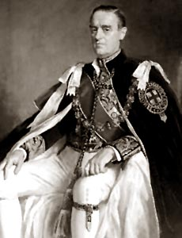
C)The White Paper published by the British government
D)Report of the joint select committees

Slide 5
PROVISIONS
Creation of an all India federation
A)This federation was to consist of British India and the princely states
B)The provinces in British India would have to join the federation but this was not compulsory for the princely states
C)This federation never materialized because of the lack of support from the required number of princely states

Slide 6
    Division of powers
A)This act divided powers between the centre and the provinces
B)There were three Lists (Federal list ,Provincial list ,Concurrent list )
C)The Viceroy was vested with residual powers

Slide 7
Provincial Autonomy
The act gave more autonomy to the provinces
Diarchy was abolished
The governor was the head of the executive
There was a council of ministers to advise him. The ministers were responsible to the provincial legislature who controlled them. The legislature could also remove the ministers

Slide 8
.
The governors still retained special reserve powers
The British authorities could still suspend a provincial government

Slide 9
DIARCHY AT THE CENTRE
RESERVED
Controlled by the governor
They were not responsible to the legislature
Subjects included defence ,power resources,justice ,taxation
TRANSFERRED
Administrated by the governor general with his council of ministers
The subjects in this list included local government ,forest,education,health....etc

Slide 10
Bicameral legislature
The bicameral federal legislature would be established.
The two houses were the federal assembly and the council of states
Federal assembly had a term of five years
In both houses there were representatives of princely states also but they were not elected

Slide 11
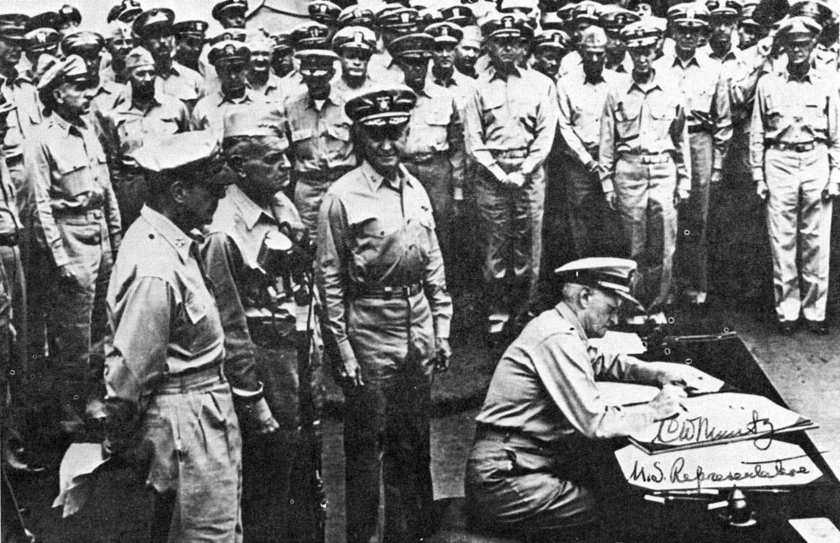
There were to be separate electorates for the minorities
Bicameral legislatures were introduced in some provinces , like Bengal ,Madras, ...etc

Slide 12
Federal Court
A federal court was established at Delhi for the resolution of disputes between provinces and also between the centre and the province
It was to have one chief justice and more than six judges

Slide 13
Indian council
The Indian council was abolished
The secretary of state for India would instead have a team of advisors
Franchise
This act introduced direct elections in India for the first time
About ten per cent of the hole population acquired voting rights

Slide 14
Reorganisation
Sindh was carved out of Bombay Presidency
Bihar and Orissa were split
Burma was severed off from India
Aden was separated from India
Other Points
A federal railway authority was set up to control Indian railways
RBI was established
Established joint public service commission
The British parliament retained its supremacy over the Indian legislature

Slide 15
BIBLIOGRAPHY
The constitutional law of India (Dr . J.N.Pandey )
Constitution of india(Mahindra Pal Sing)
The landmarks in Indian legal and constitutional history(B M Gandhi)

Slide 16
Thanks for all viewers

